Slide 1


COOL AVOCADO DATA OBSERVATIONS
https://cado-rice-data.herokuapp.com/
Notes:
Hello and Welcome to COOL AVOCADO DATA OBSERVATIONS or CADO for short.

Slide 2
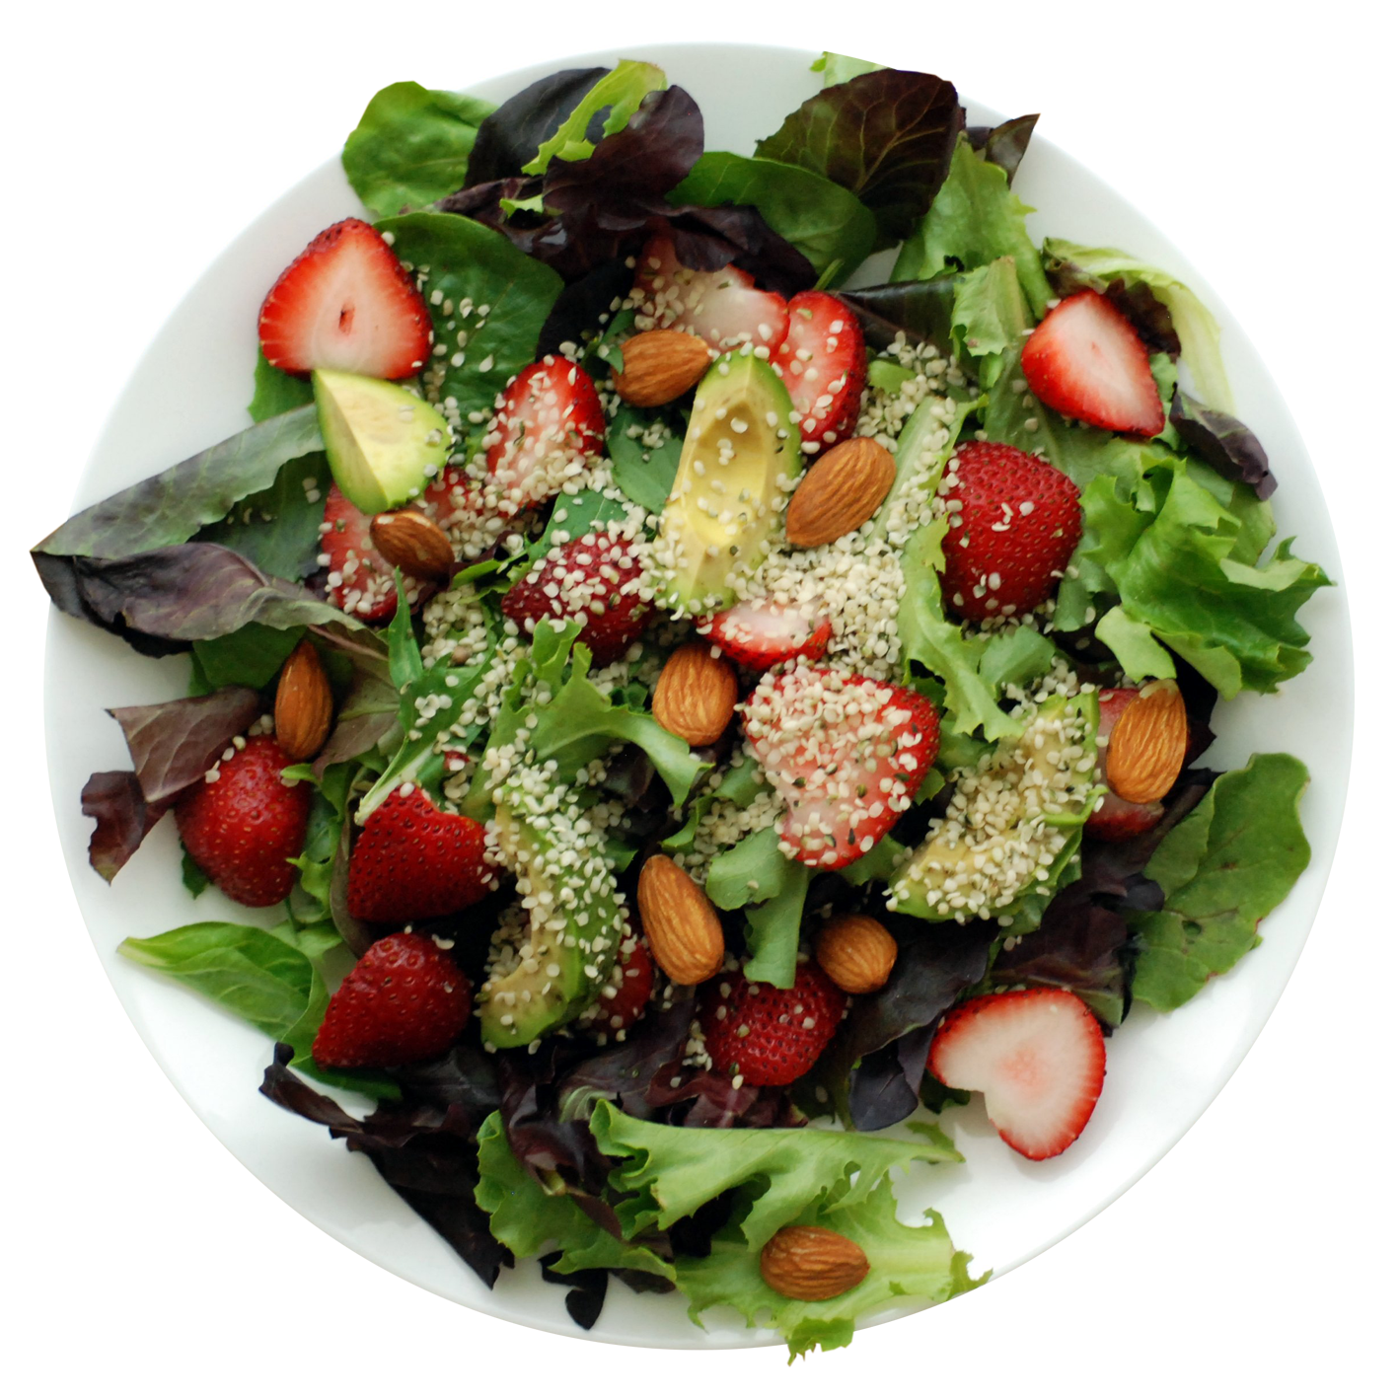
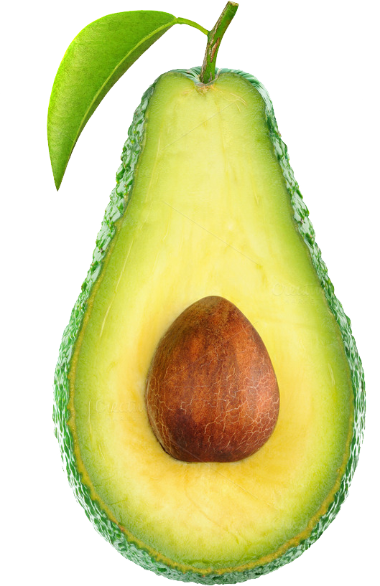
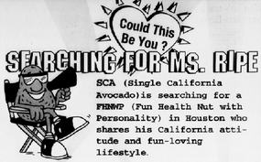
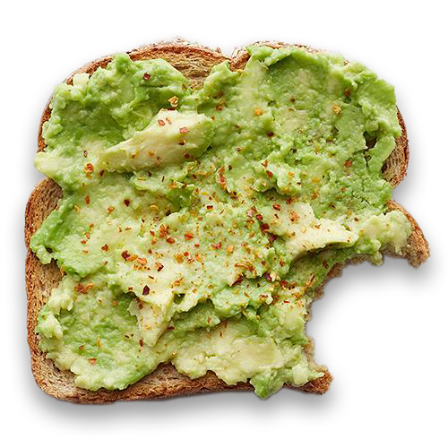
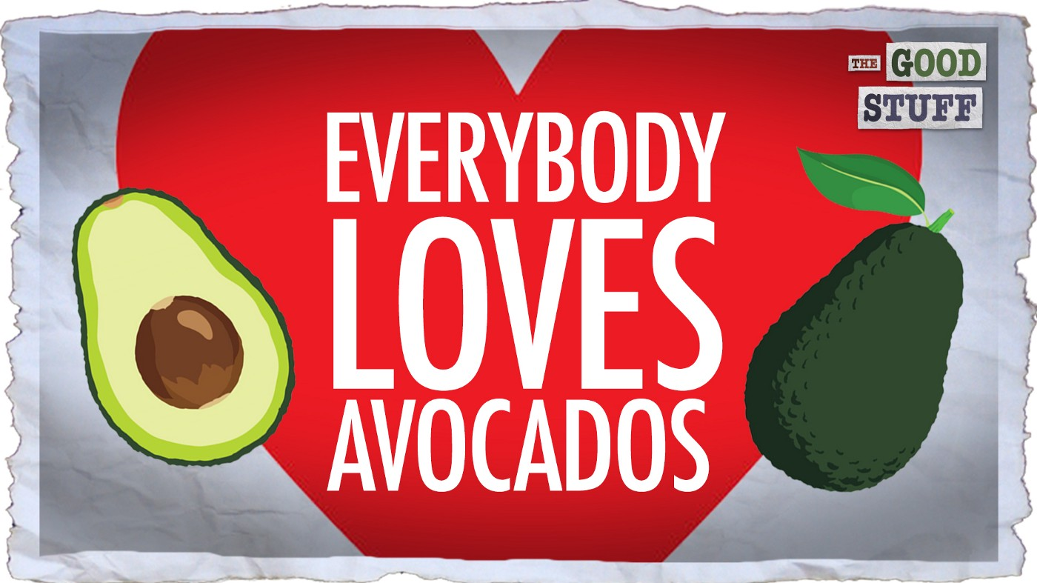
Background
Avocados are the darling of the produce section. They’re the go-to ingredient for guacamole dips at parties. And they're also turning up in everything from salads and wraps to smoothies and even brownies. What a better fruit to analyze?!?
Notes:
Today we will present our analysis of avocado prices…but let’s speak a little about the avocado itself…the darling of the produce section. Its the go-to ingredient for guacamole dips at parties, we can eat it in salads, have it in smoothies and even in desserts.

Slide 3
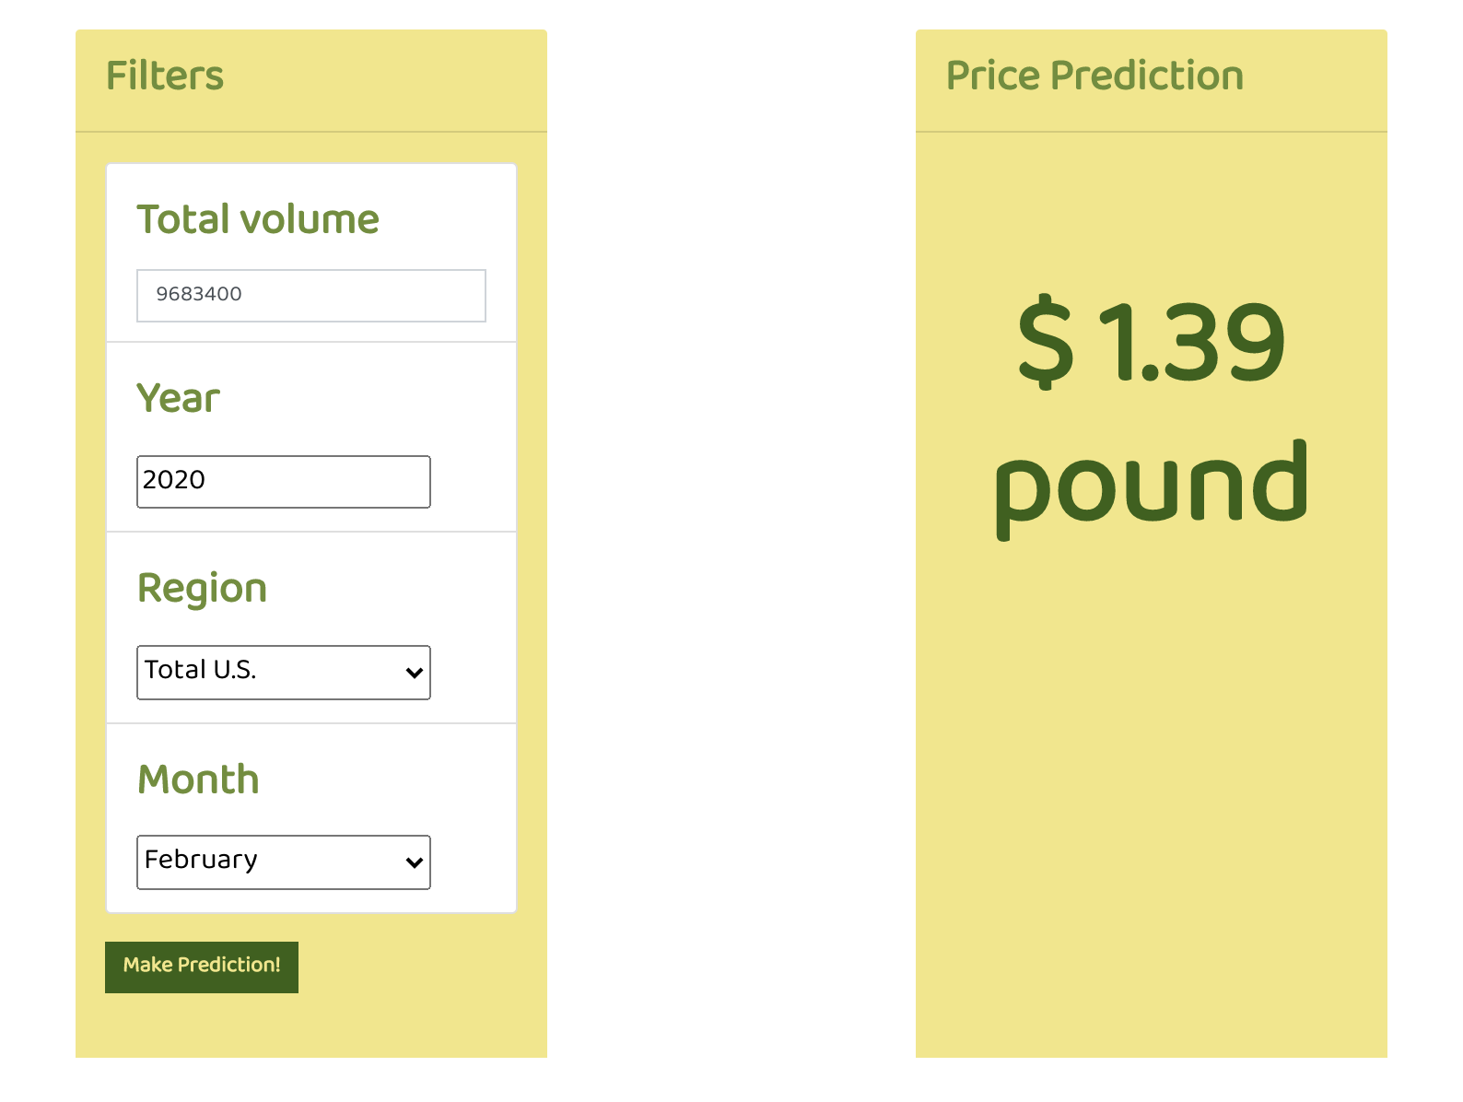
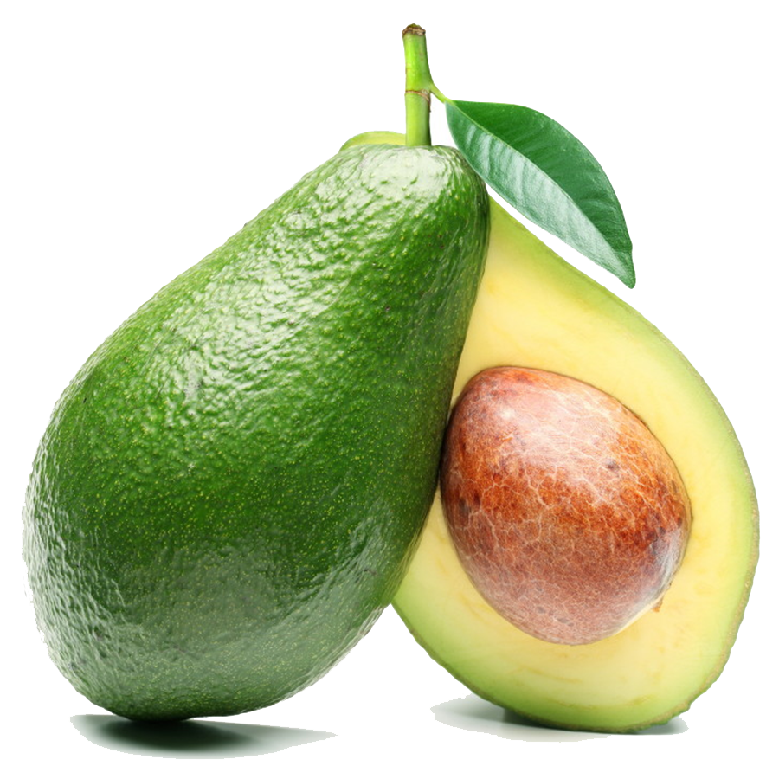
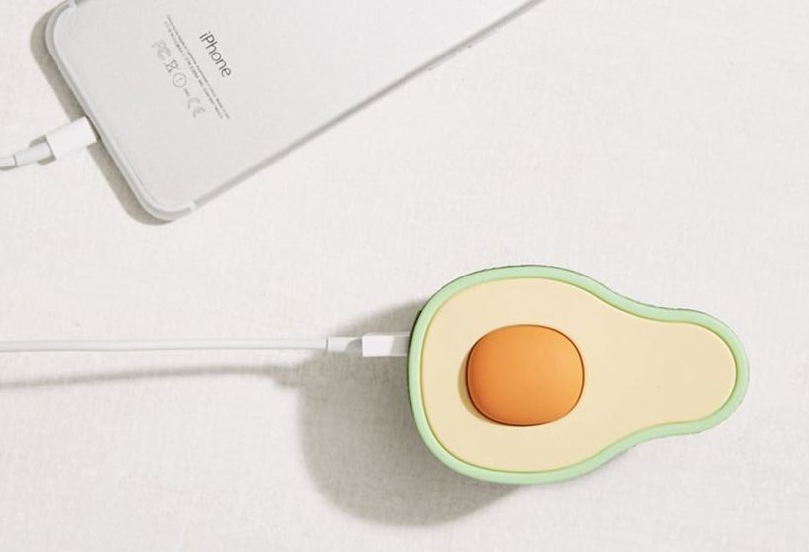
Objective
Create an application to analyze and explore data analysis and price predictions for Hass Avocados in the United States
Technologies Used
Pandas, Matplotlib, Seaborne, HTML, CSS, JavaScript, Tableau Public, Heroku, Python, D3, Flask, Scikit-learn, Github, Jupyter Notebook
Notes:
Our Objective was to create an application to analyze and explore data analysis and price predictions for Hass Avocados in the United States
The Technologies used were Pandas, Matplotlib, Seaborne, HTML, CSS, JavaScript, Tableau Public, Heroku, Python, D3, Flask, Scikit-learn, Github, and Jupyter Notebook

Slide 4
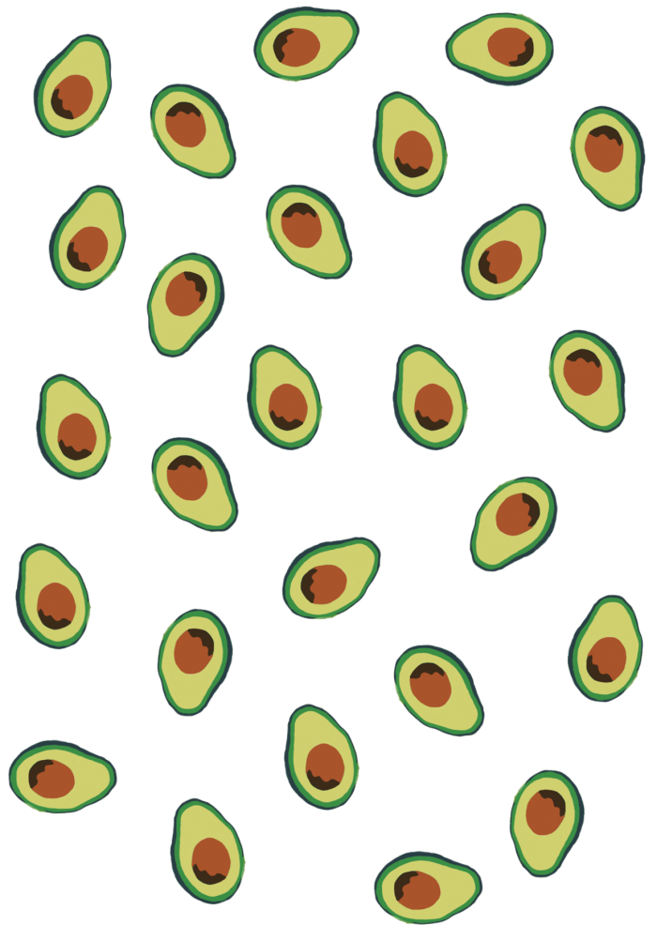
Basic Hypothesis, Trends
Avocado sales will vary directly with the season (hotter months in the countries of production will result in an increase in quantity and quality of the world's avocados.)
Avocado prices will correlate with avocado sales volume.
Notes:
The hypothesis we wanted to explore, were: ONE Avocado sales will vary directly with the season (hotter months in the countries of production will result in an increase in quantity and quality of the world's avocados.) and TWO Avocado prices will correlate with avocado sales volume.

Slide 5

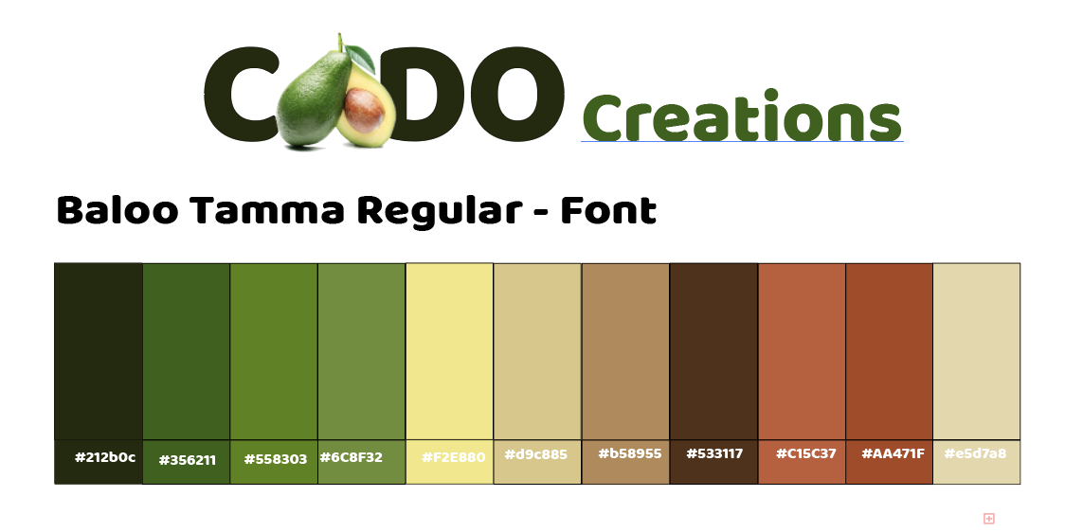
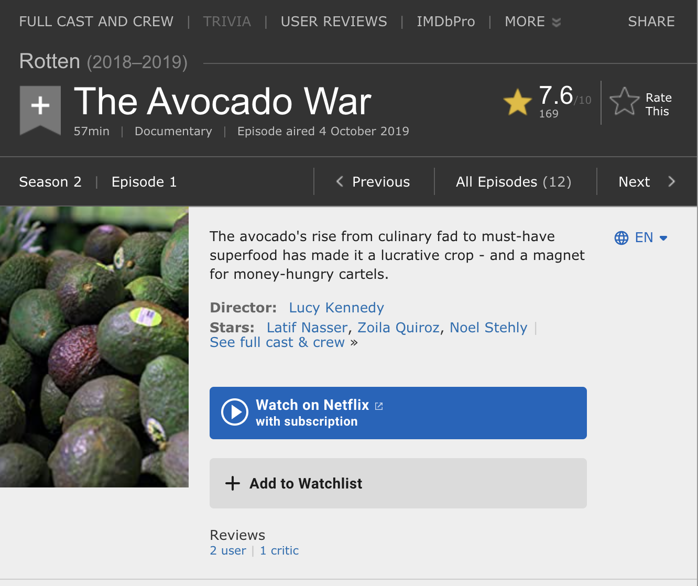

Inspirations
“…a magnet for money-hungry cartels.”
https://www.technologyreview.com/
“This avocado armchair could be the future of AI.”
https://www.imdb.com/title/tt11064620/
Notes:
Our Inspirations included the AVOCADO’s COLOR, SHAPE, and FORM.
2nd - The Netflix docuseries – “Rotten” and the episode The Avocado War that dives into the “heart of the avocado supply chain to reveal unsavory truths and expose hidden forces.”
AND thirdly the many images of the Avocado Chair obtained from an article titled: This avocado armchair could be the future of AI by Will Douglas … . In the article, Will discusses the implementation of two new models that combine Neural Language Processing (NLP) with image recognition to give its AI a better understanding of everyday concepts.
And here’s Harry to speak more about the Data and Machine Learning…

Slide 6
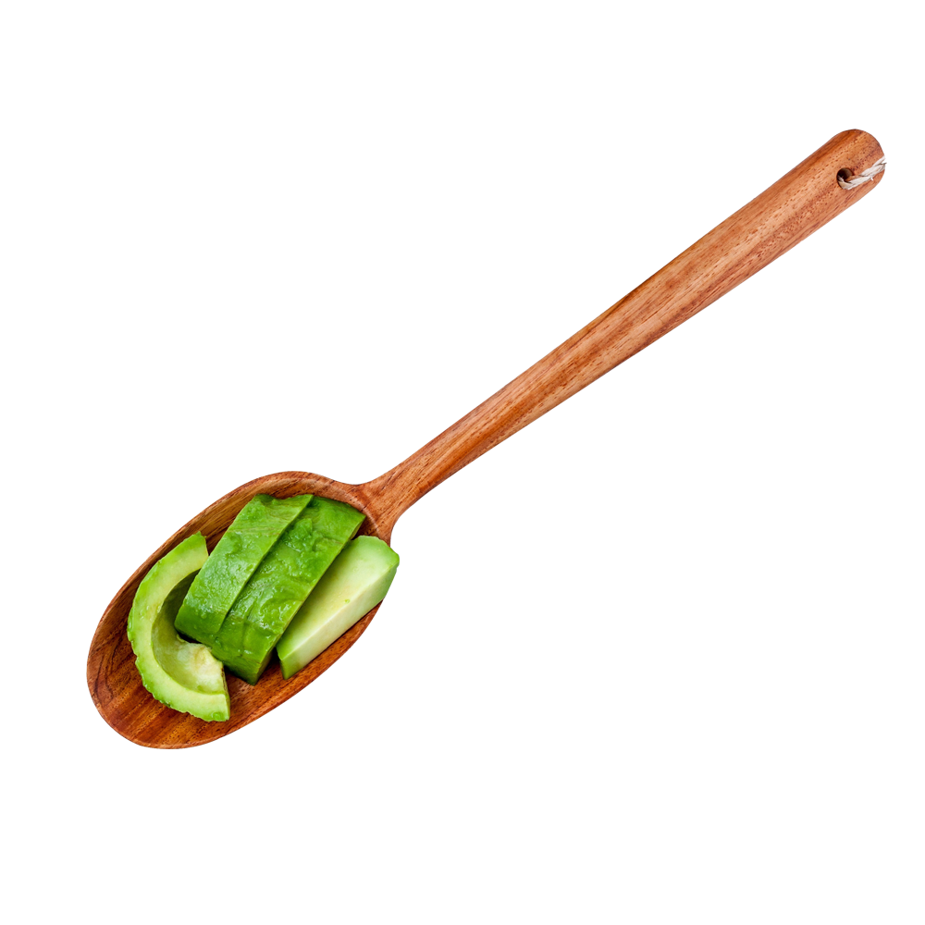
Extract the DATA
Some relevant columns in the dataset:
Date - The date of the observation
Average Price - the average price of a single avocado
type - conventional or organic
year - the year
Region - the city or region of the observation
Total Volume - Total number of avocados sold
4046 - Total number of avocados with PLU 4046 sold
4225 - Total number of avocados with PLU 4225 sold
4770 - Total number of avocados with PLU 4770 sold
Kaggle - https://www.kaggle.com/timmate/avocado-prices-2020.csv
Data used “is an updated version of the avocado dataset originally compiled from the Hass Avocado Board (or HAB, for short) data and published on Kaggle by Justin Kiggins in 2018. The dataset features historical data on avocado prices and sales volume in multiple cities, states, and regions of the USA.”
This updated version contains data from 4 January 2015 up to 17 May 2020

Slide 7
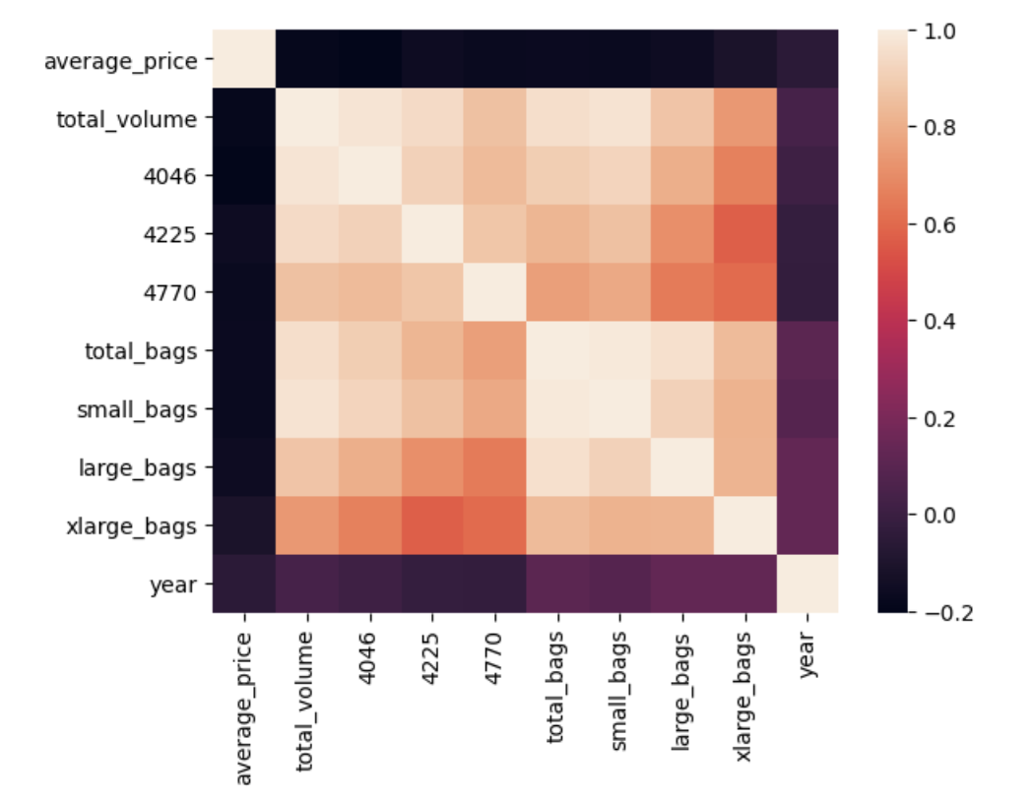
Investigating Predictions / Correlations
Price Predictions
Volume vs. Price
Affects of Seasonal changes
Differences between Organic vs. Conventional

Slide 8
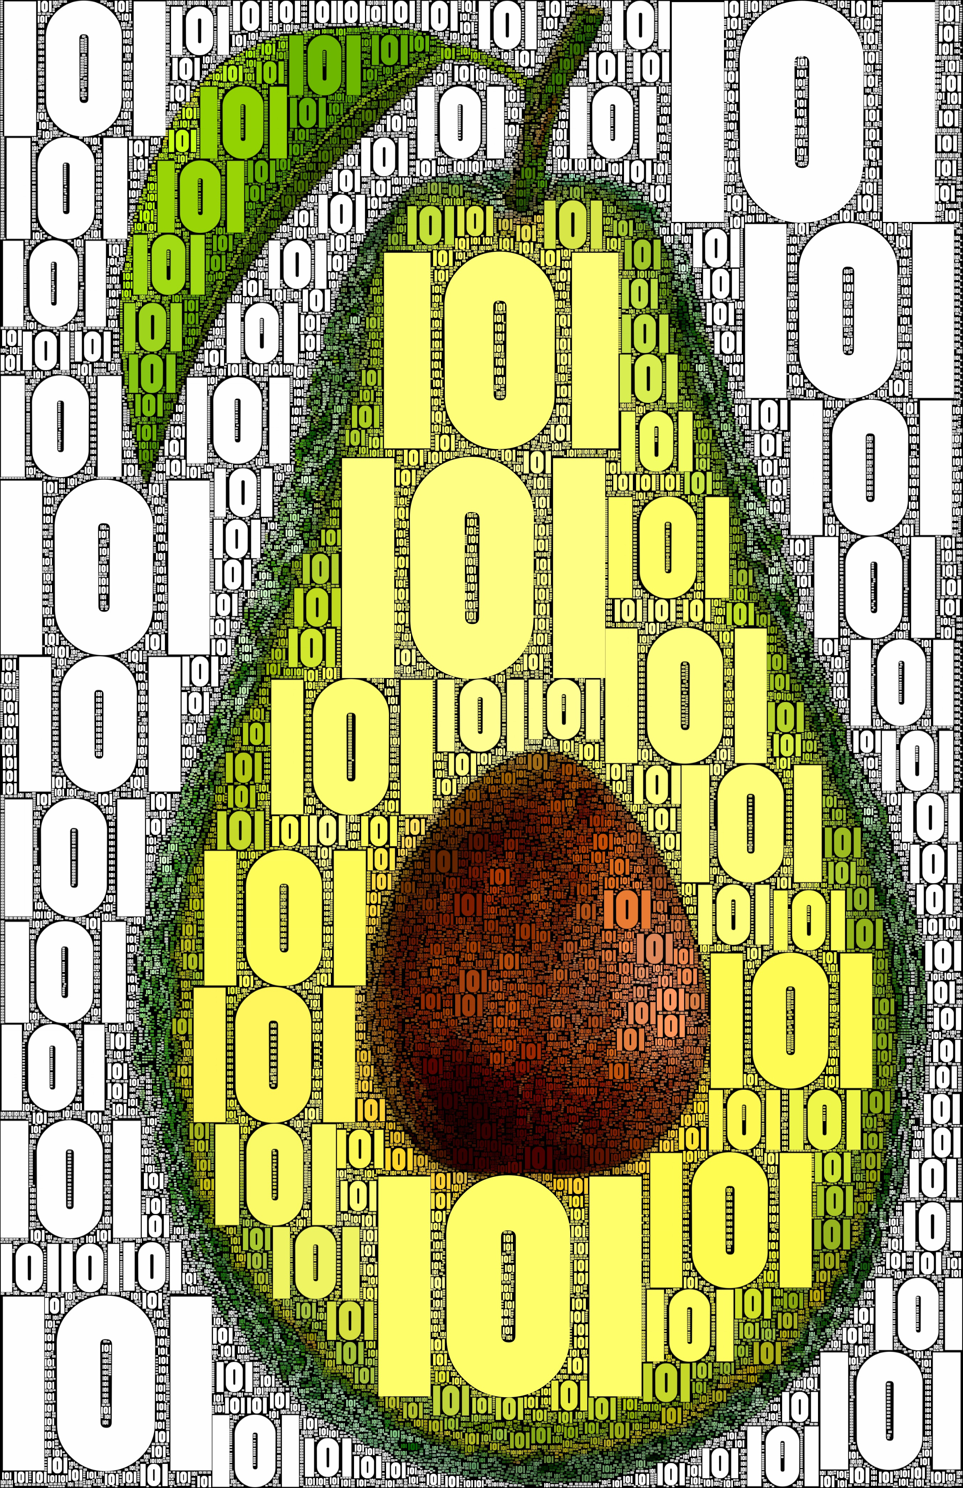
Transforming the Data
Type column (conventional/organic) – Using One-Hot Encoding for Categorical Data
Month column (1-11) – Using Label Encoding from 1 to 11 for each month respectively, excluding December per null values found in December.

Slide 9
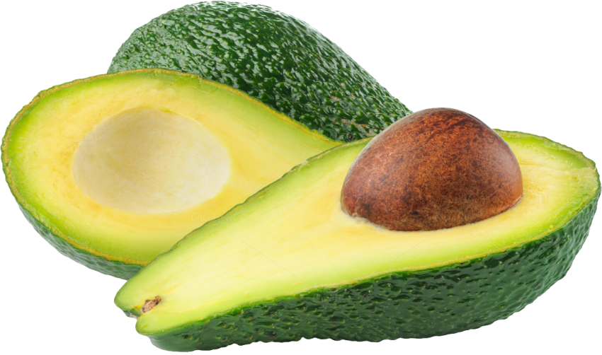
Machine Learning
Multiple linear regression
Notes:
The machine-learning portion of the avocado project is based on multiple linear regression, the oldest and most tried-and-true form of linear regression. It functions by minimizing the squared distance between predicted and actual values, where predicted values are produced by multiplying a set of input variables by a set of coefficients. These coefficients are changed until the most accurate picture is formed (i.e., the least error-prone model is created).

Slide 10
Machine Learning
We found that the most significant variables in the regression were volume of avocados.
Each region and year seem to have a significant effect on the model. Prices do not just follow a trend, but a geographical pattern as well.
Notes:
In the avocado example, this most-accurate picture turned out to be only slightly accurate. It seems that even though the price of a good is predictable (avocado prices have followed steady trends over the years), the short-term movement in that price is still highly unpredictable. We found that the most significant variables in the regression were volume of avocados. Besides that, each region and year seems to have a significant effect on the model. Prices do not just follow a trend, but a geographical pattern as well.

Slide 11
Machine Learning Deployment
Our process for Machine Learning included deploying our model using a flask app.
We utilized pickle to load and save the data to filter a user’s input to display the results
The predictions were returned as a numeric type to a jinja template in html.

Slide 12
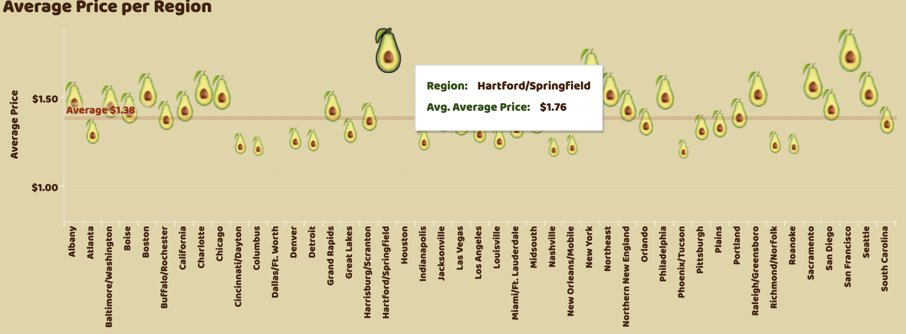
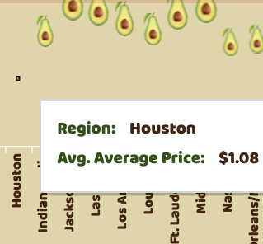
Avocado Average Price by Region
Regions like Hartford/Springfield and San Francisco have unusually high average prices ranging from $1.76 -$1.97.
Notes:
Discover what the single avocado price is in each region of the United States through the years 2015-2020
Regions like Hartford/Springfield and San Francisco have unusually high average prices ranging from $1.76 to $1.97. On the other end of the spectrum, Houston and Dallas/Ft. Worth, these regions have unusually low average prices ranging from $0.99-$1.23. The lower-than-expected average prices is an interesting result despite Tex-Mex food's popularity in these Southern cities.
In this chart, you can barely see at all, the ”avocado” representing Houston. The size of the icon is determined by the average price range values.

Slide 13
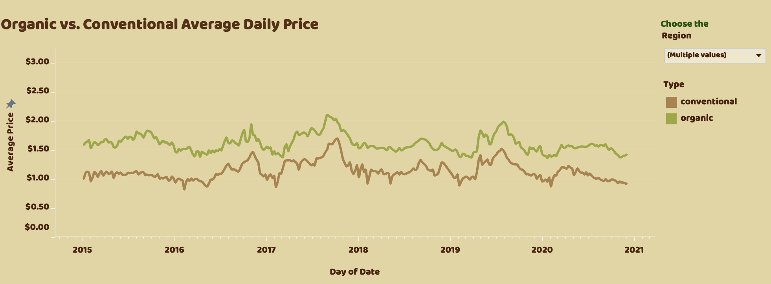
Organic vs. Conventional Average Price Comparison
Organic avocados, have always been priced higher through the years.
Production costs for organic avocados have kept the price higher
Notes:
Here we can see the comparison of the average Daily Price of Avocados between Organic vs. Conventional fruit through the years 2015 and 2020. Here we can see, the Organic avocados, have always been priced higher through the years. Undoubtedly, the price of production for organic avocados have always kept the price higher than the conventional type.

Slide 14
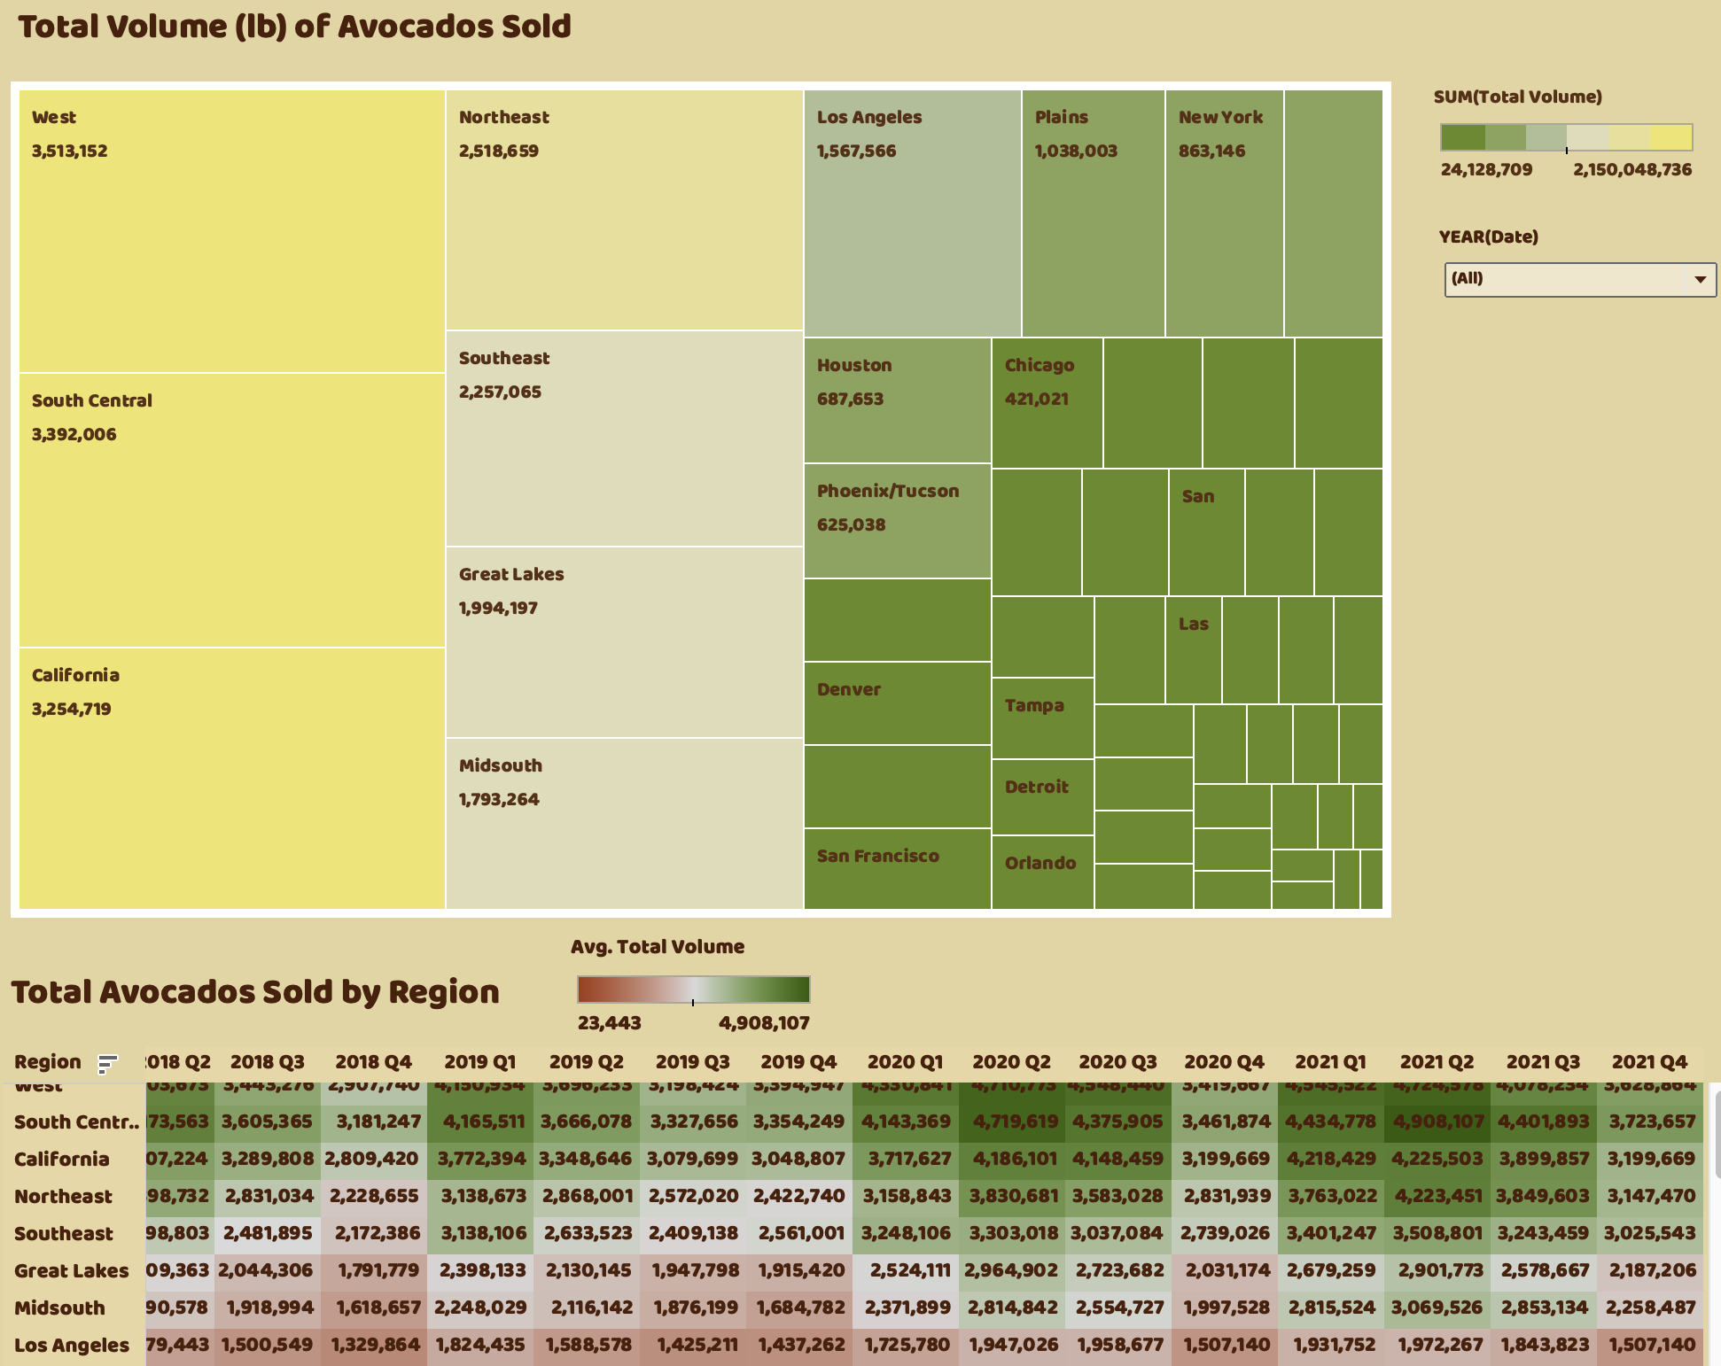
Total Volume of Avocados Sold
Winter – sales (Q4) decrease
Super Bowl – boosts sales (Q2)
Through each region and year span, the 3rd and 4th quarters generally have lower volume sales, and the 1st and 2nd quarters have higher quantities of avocados sold.
Notes:
Let's take a look at Total Volume of avocados Sold. In our app, we can choose from the drop-down menu the year you want to look at. In the chart below, we have currently used the source data from 2015 first quarter to 2020 third quarter to create a forecast through 2021 fourth quarter in Tableau. At a prediction interval of 95% we can look at potential seasonal patterns every 4 Quarters. Let's look at the visuals to see if the winter holidays or the Super Bowl parties have affected the quantities sold.
Because the avocado fruit is not necessarily an American recipe staple for Winter holidays, such as Christmas or Hanukkah, we can expect that the 4th quarter to have lower sales. Through each region and year span, the 3rd and 4th quarters generally have lower volume sales, and the 1st and 2nd quarters have higher quantities of avocados sold. Perhaps, the Super Bowl parties during the month of February and warmer temperatures in the summer make it a more inviting fruit to eat for appetizers and Tex-Mex food. In general, the volume of avocados sold has been increasing since 2015.

Slide 15
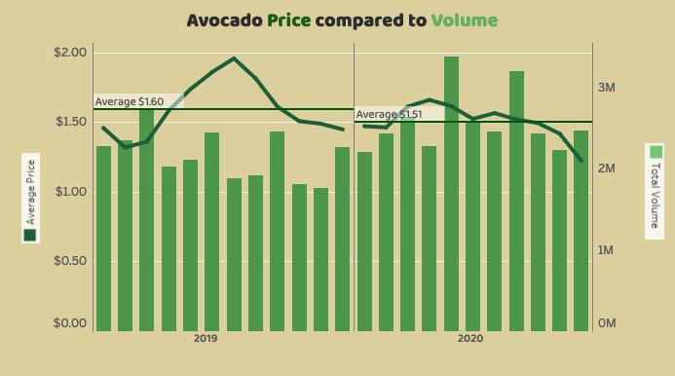
Avocado Price Compared to Volume
Here we can see the growing price of avocados from 2019 to 2020
Seasonality is always a contributing factor with avocados, but overall, the price is on the increase.

Slide 16
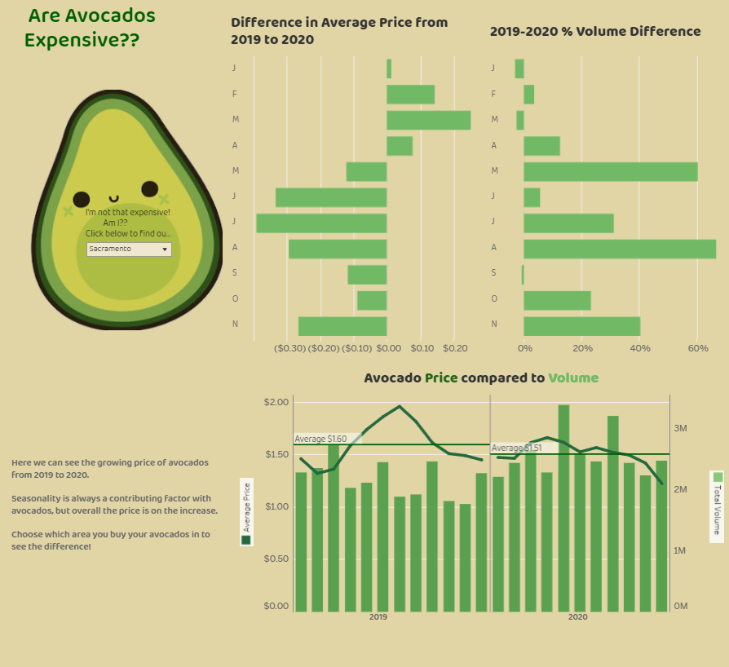
Conclusions
In 2019 we see that prices override volume. Particularly from April to December
In 2019, March had the highest volume compared to other months within that year
In 2020, The highest peak months were May and August exceeding the avg. price mark for both months
In 2020, we see that avg price takes a dive in November at $1.22 compared to a high $1.66 in April

Slide 17
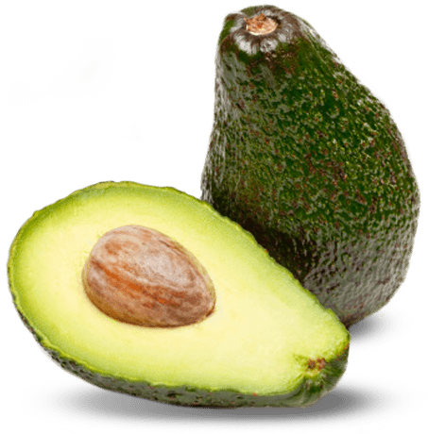
Recommendations
Limit productivity of large bags and Xlarge bags of avocados.
Increase production of smaller bags. Smaller bags are more popular for consumers to purchase. This maybe due to the avocados short shelf life of 3-4 days.
Pay attention to the peak months of April, May, July, and August when sales of avocados increase.
Develop and promote recipes with avocados as a star ingredient that can become a staple in the winter.

Slide 18
Limitations
Dataset is limiting…
It does not include weather data - conditions that would’ve affected avocado production
It does not include Manufacturing cost and Production Cycle data
The use of a mathematical model with future dates and past data doesn’t give a perfect prediction to depend on.

Slide 19
Future Work
Weather
Age groups

Slide 20




About Us
My name is Phillecia Qualls, and I'm an IT Analyst for Decision Information Resources. I hold a Bachelor's degree in Business Management, a Masters' degree in Business Administration, as well as a Masters' in Management Information Systems. People find me to be an upbeat, self-motivated team player with excellent communication skills. My experience includes designing, analyzing, and implementing efficient IT systems, planning and overseeing projects (e.g., upgrades, hardware/software installations), provide advice and technical training, and much more.
Passionate Data Analyst. Team worker with great ability to learn and able to quickly adapt to a new environment, global mindset and fluent in English and Spanish. Interested in KPI’s, Dashboard, ETL, Data Analysis, Data Engineering, Databases and Data maps.
Industrious, multifaceted Data Analyst with skills in Graphic Design and Education. Having a dedication for collecting and rearranging data into a clear, understandable narrative. Tackles projects within collaborative teams and independently to enable the data to be simply broken down, displayed and interpreted by all. Passionate for the details and producing solutions to problems.
I am a self-taught programmer with an intense interest in classical Economics. I am currently pursuing a major in Economics at Tulane University. I love numbers and solving problems, and I hope to one day start my own small business.

